Slide 1
ECMAScript Process Documents
Kai Waløen 15/05/2025

Slide 2
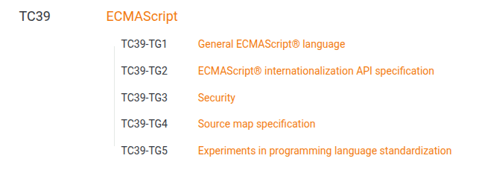
Ecma International
Ecma International
  Standardization Organization
  Standards: ECMA-1 → ECMA-499
    Notable mentions
      ECMA-334: C# Programming Language
      ECMA-404: JSON
      ECMA-408: Dart Programming Language
ECMAScript Specifications:
    ECMA-262: ECMAScript Language Specification
    ECMA-402: ECMAScript Internationalization API Specification
Technical Committee and Task Groups
  TC39 works on ECMAScript
https://en.wikipedia.org/wiki/List_of_Ecma_standards

Slide 3
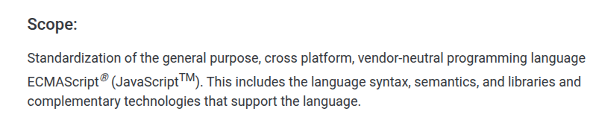
ECMAScript vs JavaScript?
ECMAScript == JavaScript
  “JavaScript” is trademarked by Oracle
    Created by Brendan Eich
  “ECMAScript” is a registered trademark by Ecma International

Slide 4
TC39 Process
Overview:
  Ecma Technical Committee 39 (TC39) is responsible for evolving the ECMAScript programming language and authoring the specification.
  The committee operates by consensus.
  No concept of rejection
  Operate by 6 Stages
  The committee must approve proposal to progress to next stage
https://tc39.es/process-document/

Slide 5
Roles
Champion
  Author of proposals
  Responsible for evolution of the proposal
  Presenting the proposal to the committee
Reviewer
  Anyone can be a reviewer
  Give feedback to the Champions
  Cannot be a Champion of the proposal
Editors
  Responsible for structure and coherence of the specification and spec-texts
  Provide guidance and feedback to spec text authors to assist in proposal maturation
  Integrate additions of approved proposals into a new revision of the specification
  May or may not be a Champion
Committee delegate
  Vote on approval of a proposal
  Can give feedback on proposals and can give conditional approval and work with the Champion to work towards approval

Slide 6
Stages

Slide 7
Yearly approval of new standard

Slide 8
About Consensus

Slide 9
Observations

